Slide 1


AI in Geo

Slide 2

The Buzzwords
Artificial Intelligence (AI)
Umbrella term that started in the 1950s
DL/ML are subsets of AI
Machine Learning (ML)
Algorithms to find patterns in data then uses models to make predictions
Deep Learning (DL)
Multilayered neural networks composed of serval hidden layers

Slide 3
Traditional Machine Learning Spaces
RETAIL
MARKETING
HEALTHCARE
FINANCE
Demand Forecasting
Supply Chain Optimization
Price Optimization
Market Segmentation
Recommendations
Recommendation Engines
Targeting
Click-stream analysis
Social Media Analysis
Ad Optimization
Predictive Disease Risk
Diagnostics and Alerts
Fraud
Risk Analytics
Customer 360
Fraud
Credit Scoring
GeoSpatial
Notes:
Talk about traditional ML in market space then say we can put a spatial twist on everything.

Slide 4
Machine Learning Types
Supervised
Unsupervised
Classification
Naïve Bayes
SVM
Random Decision Forests
Regression
Linear
Logistic
Clustering
K-Means
DBSCAN
Dimensionality Reduction
PCA
SVD
LABELED DATA

Slide 5
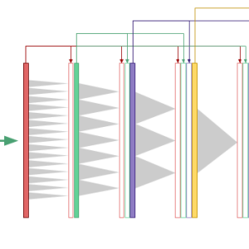
Deep Learning
Subset of ML
Tries to mimic the human brain
Common Algorithms
Convolutional Neural Networks (CNN)
Deep Belief Networks
Recurrent Neural Networks (RNN)
Tries to “LEARN” the best features needed to represent the given data

Slide 6
The Learning Steps
Contain Patterns
Finds Patterns
Recognize Patterns
Training
Data
Build Model
New Data
Use the Model
Predictions

Slide 7


Computer Vision on GeoSpatial Imagery
Object Detection
Finds objects within images in terms of bounding boxes
Good for feature extraction and anomaly detection
Pixel Classification
Process of image segmentation where each pixel is put into a class
Example: Land Cover Classification or Extracting Road Networks
Notes:
Create graphics

Slide 8
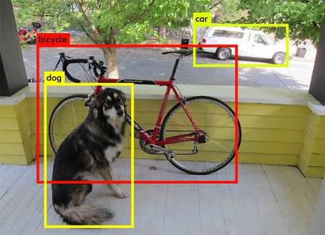
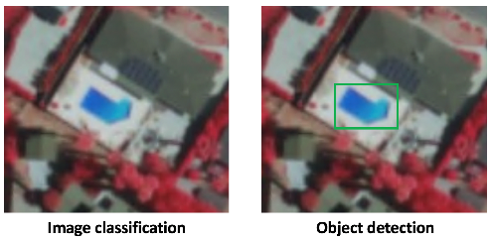
Single Shot Detector
Basic idea is single network (for speed) and no need for region proposals instead it uses different bounding boxes and then adjust the bounding box as part of prediction
Predicts the object is in an image
Locates the bounding box of the object
Different models and implementations may have different formats, but the idea is the same, which is to output the probability and the location of the object.

Slide 9
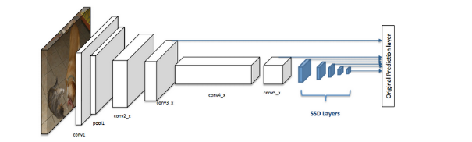
Parts of Single Shot Detector
SSD has two components:
A backbone model - model usually is a pre-trained image classification network as a feature extractor
SSD head - one or more convolutional layers added to this backbone and the outputs are interpreted as the bounding boxes and classes of objects in the spatial location of the final layers activations

Slide 10
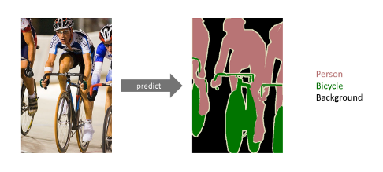
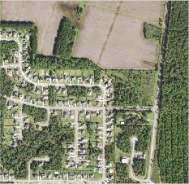
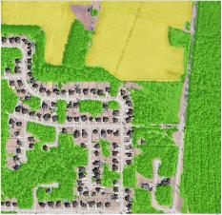
U-NET
U-Net is a Fully Convolutional Network (FCN) that does image segmentation.
The goal is to predict each pixel’s class
Use to do Semantic Segmentation
Advantages of Using U-Net
Computationally efficient
Trainable with a small data-set
Trained end-to-end

Slide 11
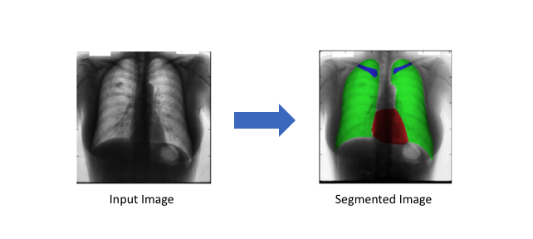
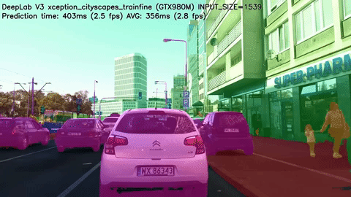
U-NET Applications
Autonomous Vehicles
Medical Image Diagnosis
Precision Agriculture
LU/LC classification

Slide 12
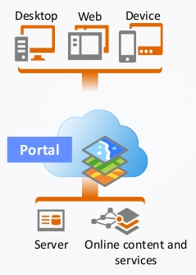
ArcGIS is a Platform for Deep Learning
Helps with deep learning workflows:
Data labeling and preparation
Training deep learning models
Model deployment
ArcGIS Pro and Image Server to perform deep learning
ArcGIS API for Python allows access to every step of the deep learning workflow in a programmatic way
Provides a seamlessly integration with other components of the platform.
Notes:
TODO: Clean up text make graphics

Slide 13

The arcgis.learn module
Easily adopt and apply deep learning to your workflows
Provides a simple, intuitive API
Fine tuning pretrained models on satellite imagery
Leverage fast.ai's learning rate finder and one-cycle learning
Integrates seamlessly with the ArcGIS platform
This module includes methods and classes for:
Exporting Training Data
Data Preparation
Model Training
Model Management
Inference
Notes:
The arcgis.learn module in ArcGIS API for Python enable GIS analysts and geospatial data scientists to easily adopt and apply deep learning in their workflows. It enables training state-of-the-art deep learning models with a simple, intuitive API. By adopting the latest research in deep learning, such as fine tuning pretrained models on satellite imagery, fast.ai's learning rate finder and one-cycle learning, it allows for much faster training and removes guesswork in picking hyperparameters. It integrates seamlessly with the ArcGIS platform by consuming the exported training samples directly, and the models that it creates can be used directly for inferencing (object detection and pixel classification) in ArcGIS Pro and Image Server.

Slide 14

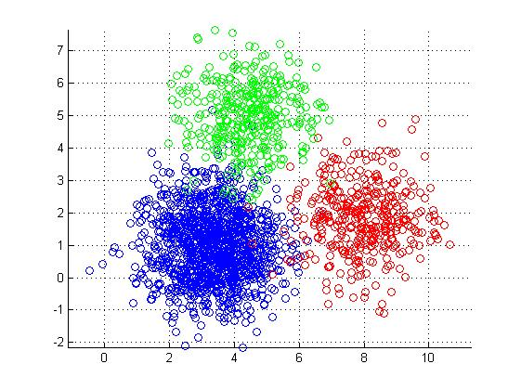
K-Means Clustering
Unsupervised Machine Learning

Slide 15

Seagrass Prediction
Supervised Machine Learning

Slide 16
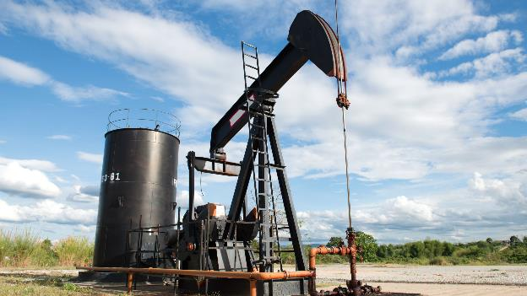
Oil Well Detection with Deep Learning

Slide 17
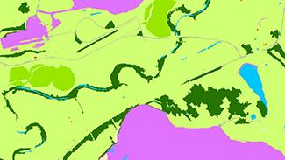
LU/LC Classification

